Slide 1






RAG Q&A Wikipedia Chatbot
Presented by:
Nitay Levy and Elisha Azaria

Slide 2






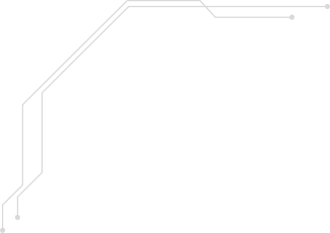
Research Questions
Performance
Accuracy
How well can Flan-T5 perform compared to a decoder-only LLM like LLaMA-2?
Does fine-tuning Flan-T5 or LLaMA-2 improve the overall accuracy of predictions?
Retrieval
Prompting
How accurately can we retrieve chunks of Wikipedia articles that are correctly related to the questions and contain the answers?
Does one-shot prompting help these models perform better than zero-shot?

Slide 3

Dataset
Question-Answer Dataset
The dataset was downloaded from Kaggle and it contains around 1800 questions with answers (we used 602 to reduce training time), along with 690,000 words of cleaned text from Wikipedia that were used to generate the questions.
Data Preprocessing
We removed duplicate and incomplete rows, and cleaned the text by removing special characters and redundant whitespace.

Slide 4
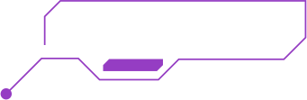


RAG Pipeline
Loading 1
Loading 2
Retrieval
Preprocessing
Storage & Embeddings
Retrieval
Each Wikipedia article was segmented into manageable chunks of text (usually paragraphs or a few sentences).
For our experiments, we set the chunk size to 200 tokens for Flan-T5 and 300 tokens for LLaMA.
We used the sentence-transformer All-MPnet Base V2 to convert the article chunks 768-dimensional dense vector space.
We then stored these embeddings in a FAISS vector database.
We retrieved relevant context by computing the cosine similarity between the query and each text chunk.
The retriever then selected the top 4 most similar chunks, which were inserted into the prompt to support the model’s response.

Slide 5




LLMs Overview
FLAN-T5
FLAN-T5 is an Encoder-Decoder transformer by Google. We used the Base version, with 248M parameters.
LLaMA-2
LLaMA is a family of Decoder-Only large language models released by Meta AI. We used the 7B parameter version of LLaMA 2.

Slide 6
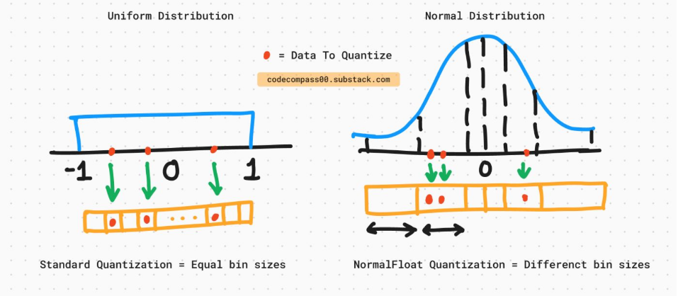
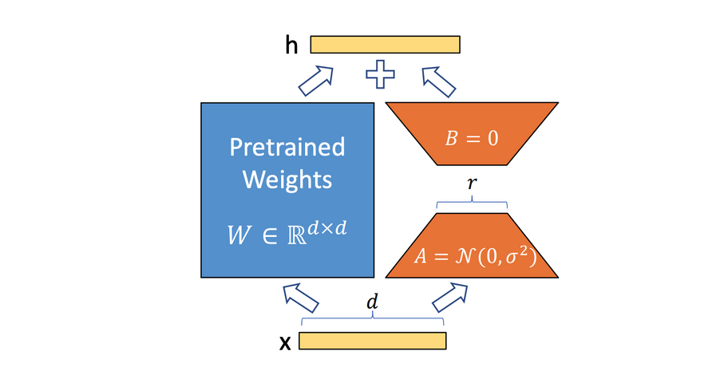
Fine Tuning
Quantization
We used the bitsandbytes library that provides quantization tools for LLMs through a lightweight Python wrapper around CUDA functions. When fine-tuning Llama, we compressed it by using a 4-bit normal-float quantization technique.
PEFT with LoRA
Both models were fine-tuned with LoRA. We tested multiple ranks and found rank 8 to return best results.

Slide 7
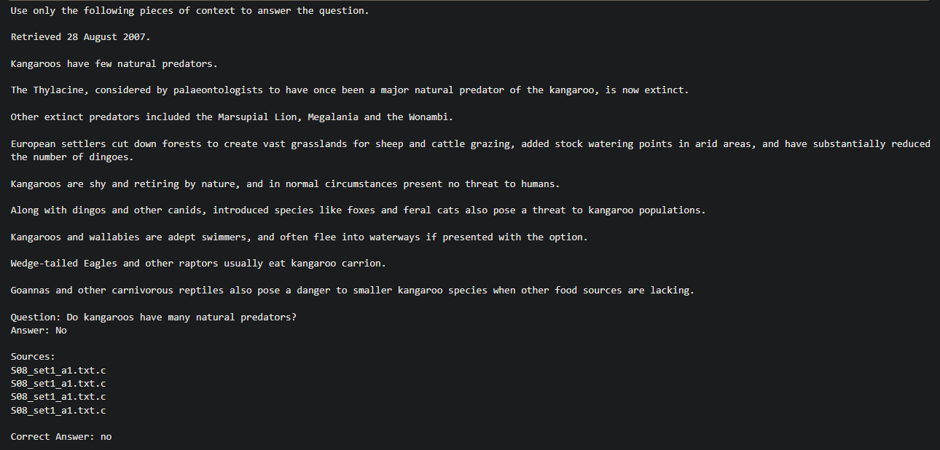
Inference Example

Slide 8




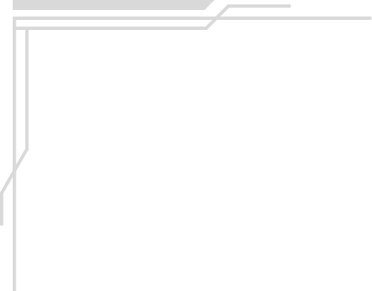

Evaluation Metrics
ROUGE-Recall
ROUGE-1 F1
ROUGE-2 F1
Measures how many words from the correct answer appear in the model’s prediction. This metric is not penalized when the prediction is more detailed than the correct answer.
Measures the overlap of words between the correct answer and the guess. I.e., how many words from the correct answer appear in the prediction, and how many words in the prediction are not in the correct answer
Measures the overlap of bigrams (pairs of words) between the correct answer and the guess.

Slide 9
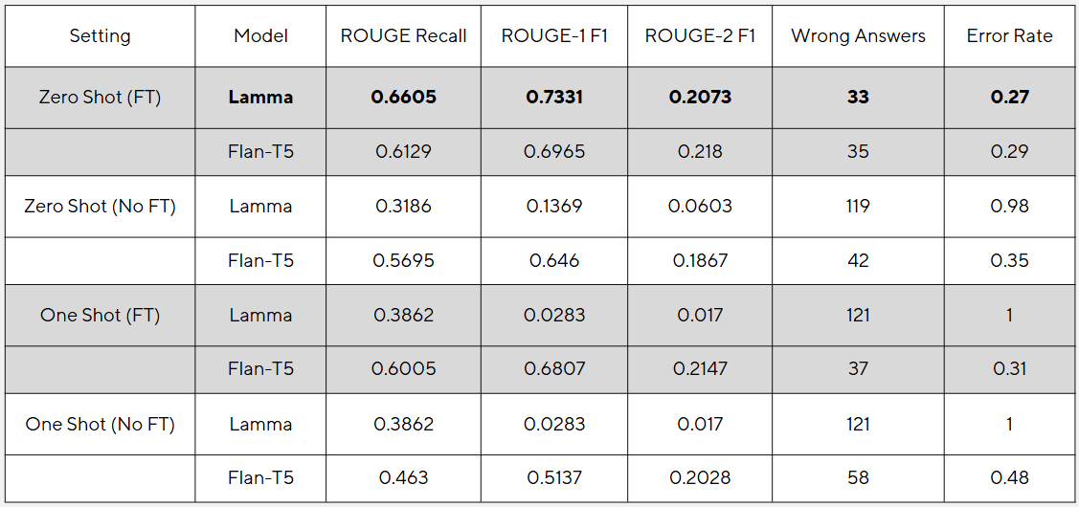
Results
Answer Evaluation

Slide 10
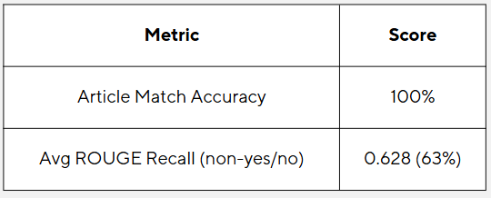
Retrieval Evaluation

Slide 11
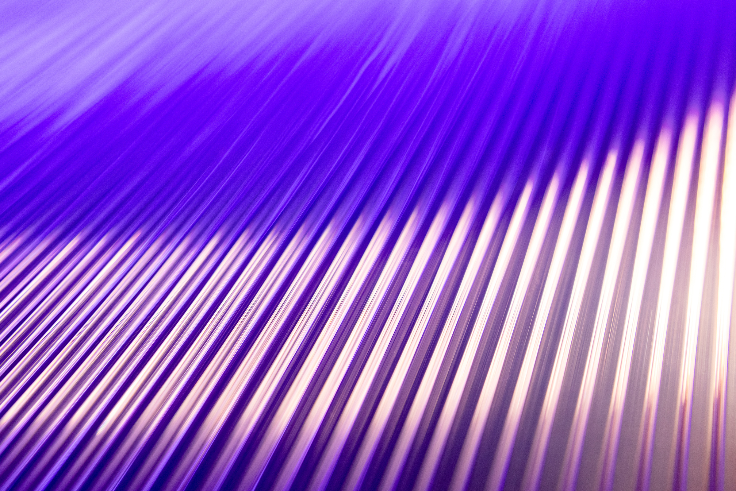

Thank You For Listening!

